Slide 1
Presidential Voter Turnout by County

Slide 2
Objective
Analyze voter turnout by county for the 2016 and 2020 presidential elections.
Which Illinois counties were changing the most in the last 4 years?
API used for 2016 election:
https://data.world/kidpixo/election-usa-2016-results
API used for the 2020 election:
https://www.kaggle.com/unanimad/us-election-2020?select=president_county.csv

Slide 3
Transformations
Create 2016 total votes by county based on candidate vote count
Normalize county columns in both dataframes
Merge the dataframes based on county name
Create percent change column
Isolate Illinois counties into separate dataframe to find min and max percent change

Slide 4

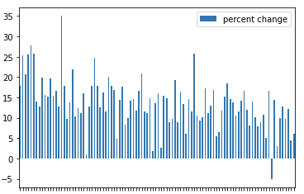

Percent Change vs. Illinois County
Lowest voter turnout change in Illinois
Highest voter turnout in Illinois

